Slide 1
Breaking Down the Ivory Tower Tapping into the potential of community science
Janette Edson
RezBaz Brisbane 2018
#RezBaz18

Slide 2
Who am I?
Day Job: Sequencing Manager at QBI/UQ
A rare staff scientist!
Method development rather than one specific research question
High throughput genomics
Previously – forensics, ancient DNA, old genomics technology
Background is wet lab but moving into software development
Also a full blown arm-waving promoter of all things science!
Organiser of BioBase QLD

Slide 3
Science Has a Problem

Slide 4
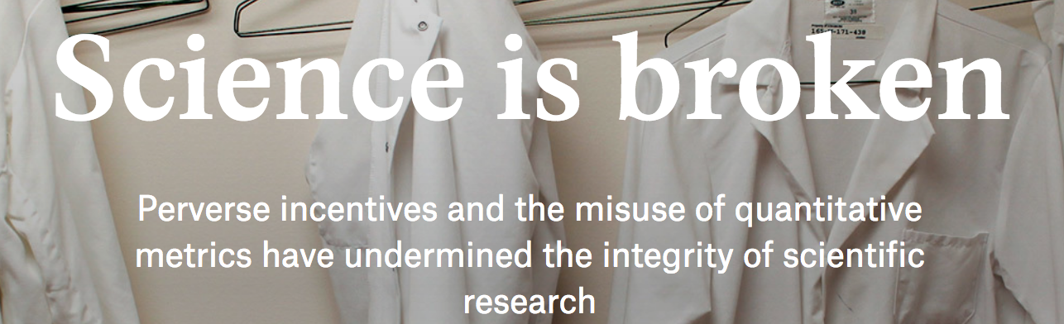
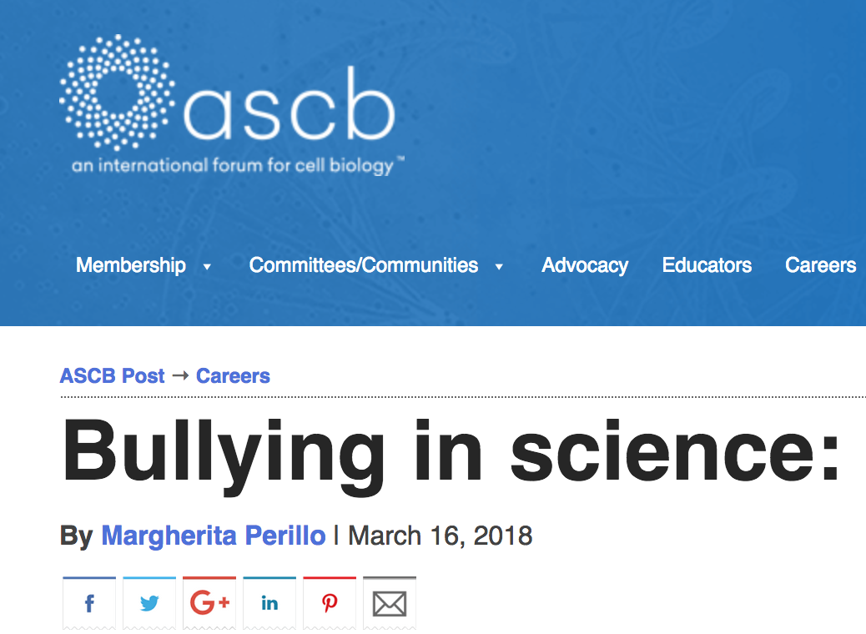
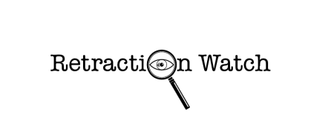
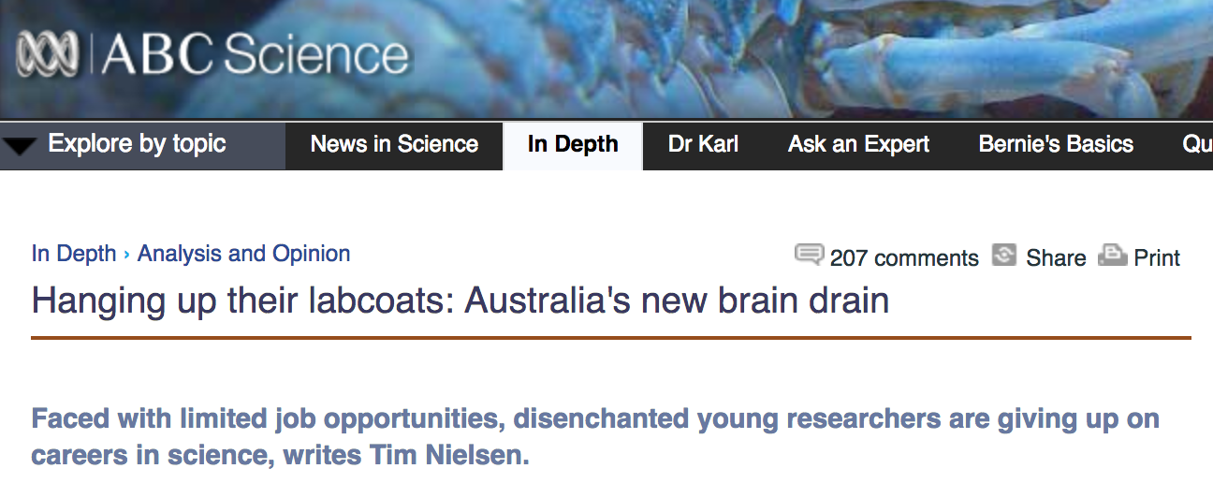

Slide 5
Issues
Impact factor over knowledge
Public engagement and education
Funding
Culture
Relevancy
Safe – no risk, no reward
Everything has to have an outcome
Everything is behind closed doors – push for open access
The model we have built doesn’t work
What to do? Other than scream?

Slide 6
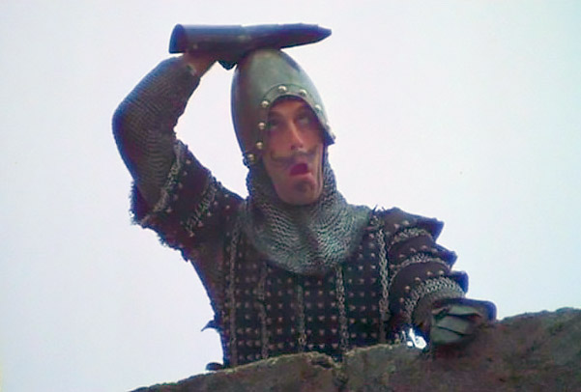
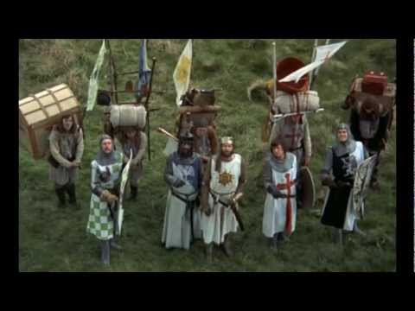
US
THEM

Slide 7
“Them”
Fund most of researcher’s work
Have ideas and skillsets that could be useful to the industry
Many want to do science BUT lack access and skills
Results in ‘biohackers’ who are in garages trying to do things and failing miserably
Potentially could help rather than hinder the need to build a new system

Slide 8
Biohacking is not a good word
Controversial
Has several meanings
Always will be ‘rogue’ individuals
Prefer to say citizen scientists or DIY-Scientists
Key reason to engage – prevent citizen science becoming tarred with the brush of a few

Slide 9
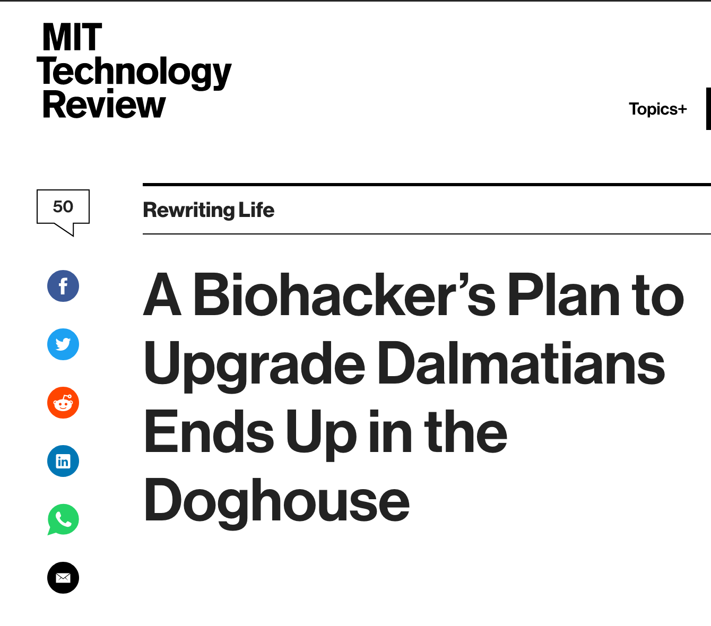
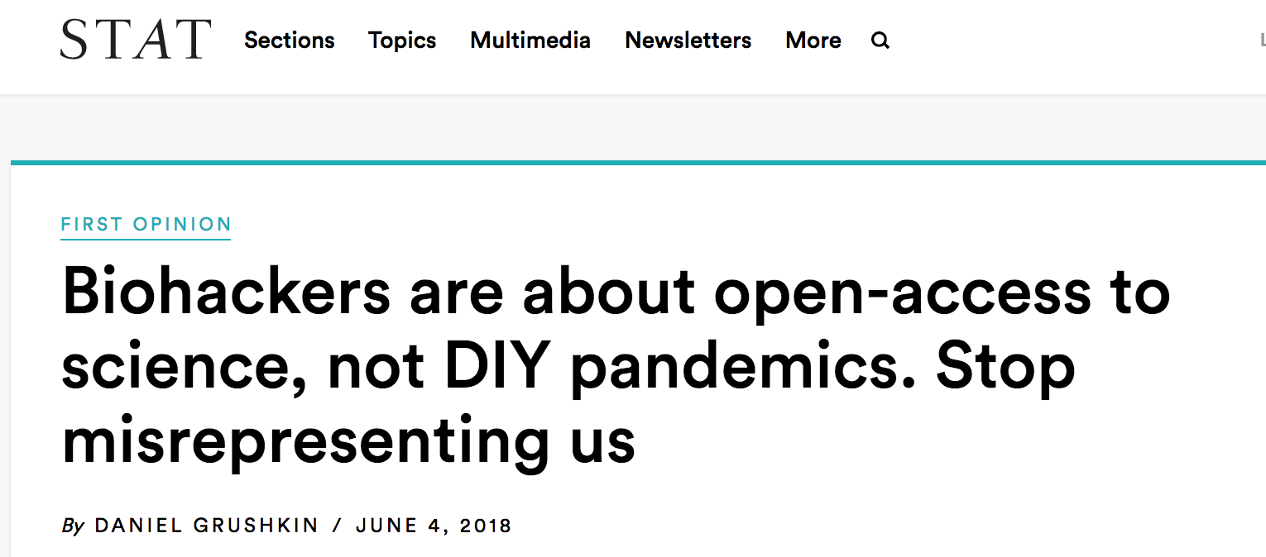

Slide 10
Ask yourself?
Why do we only hack for a couple days at a time?
How to bring sustainability
How to bring innovation
How to do it cheaply
How to engage the public

Slide 11
Not a new concept
Began as underground movement
Freedom to work on questions of interest
Collaborate more broadly – art, science, data etc. etc
Maker space for science
Provide space for startups to build product
Taking citizen science from ‘stamp collecting’ to projects
OpenInsulin
iGEM
Both overseas and here

Slide 12
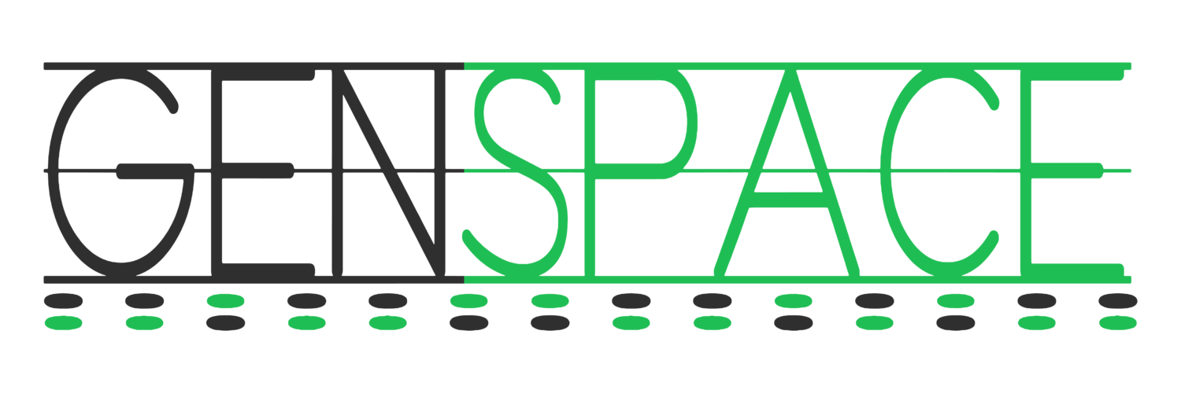
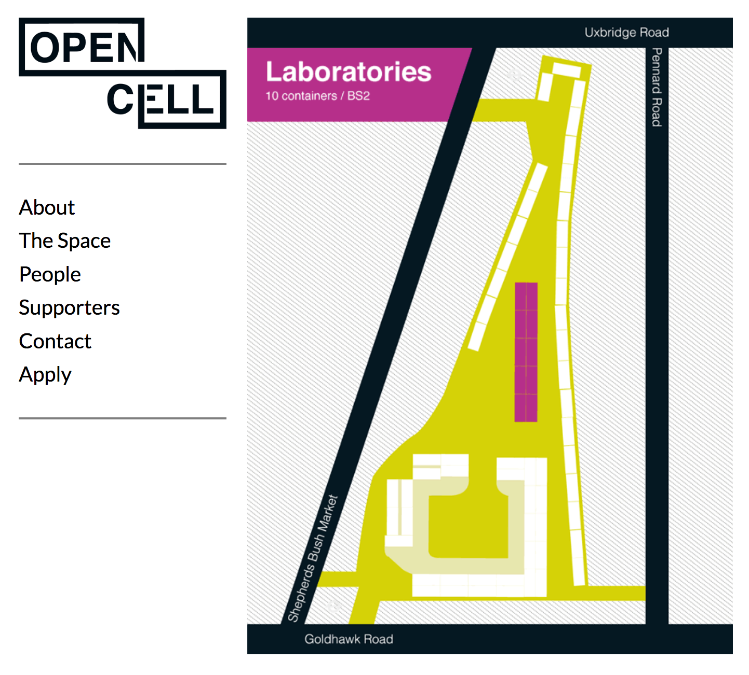



Slide 13

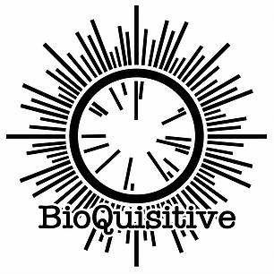
Australia

Slide 14
BioBase –QLD!
Vision: bring anyone who wishes to do science in some form together
Contribute to creating a new ‘science’ which is more integrated into society
Scientific MakerSpace
Project led
Taking a slightly different approach
Lab space is expensive
Science also requires skill
Link up those with ideas + those with the skills
Who knows what could be built/made/repurposed?
Space to talk and explore science
Workshops for ADULTS
Meetings once per month

Slide 15

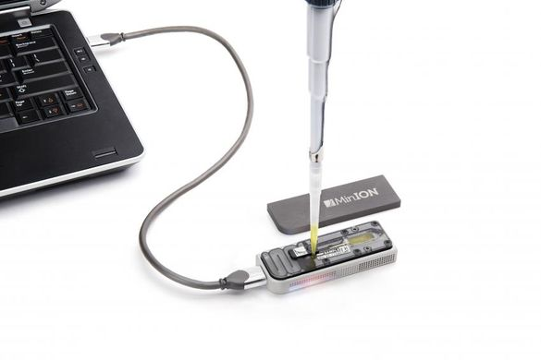
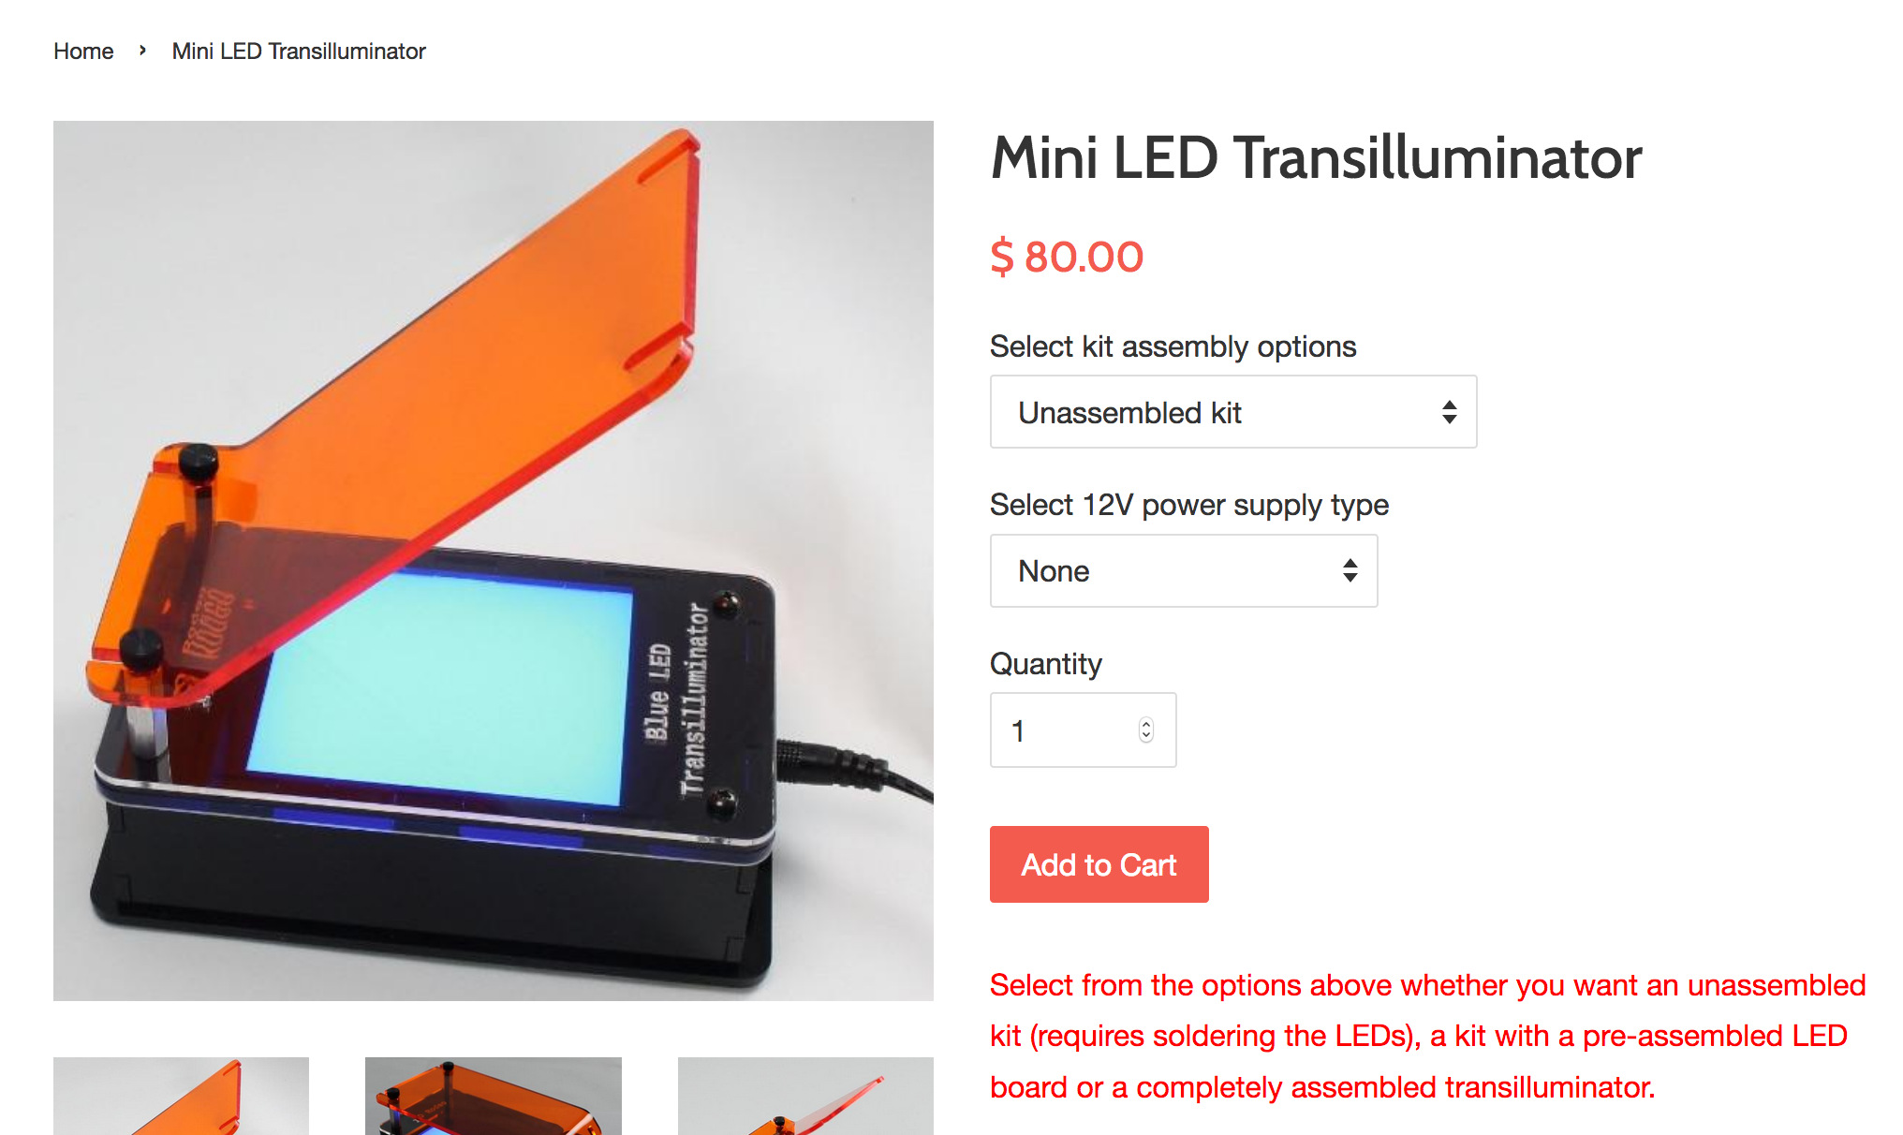
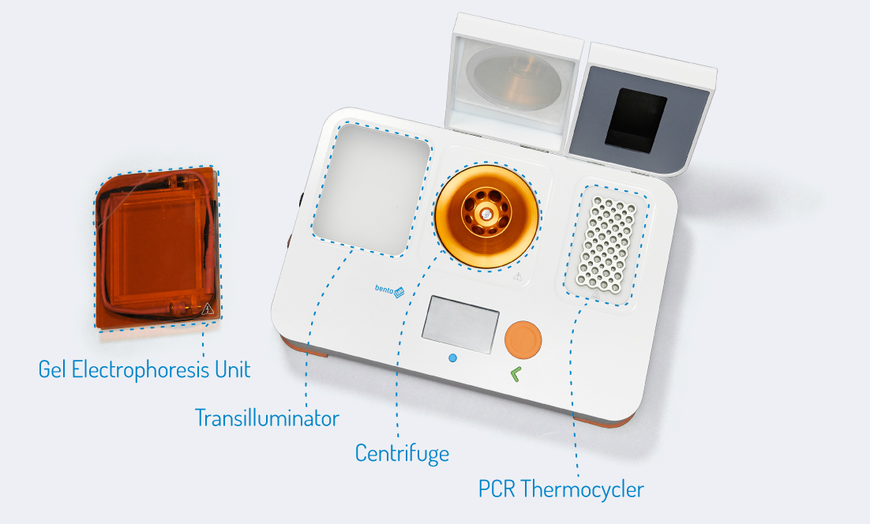
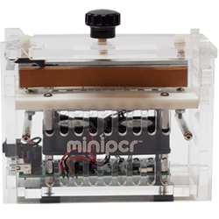

Slide 16
Even funding is moving to open –source…..

Slide 17
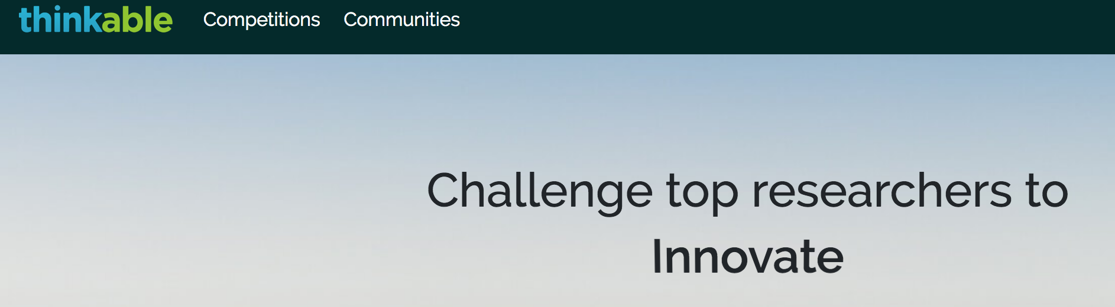

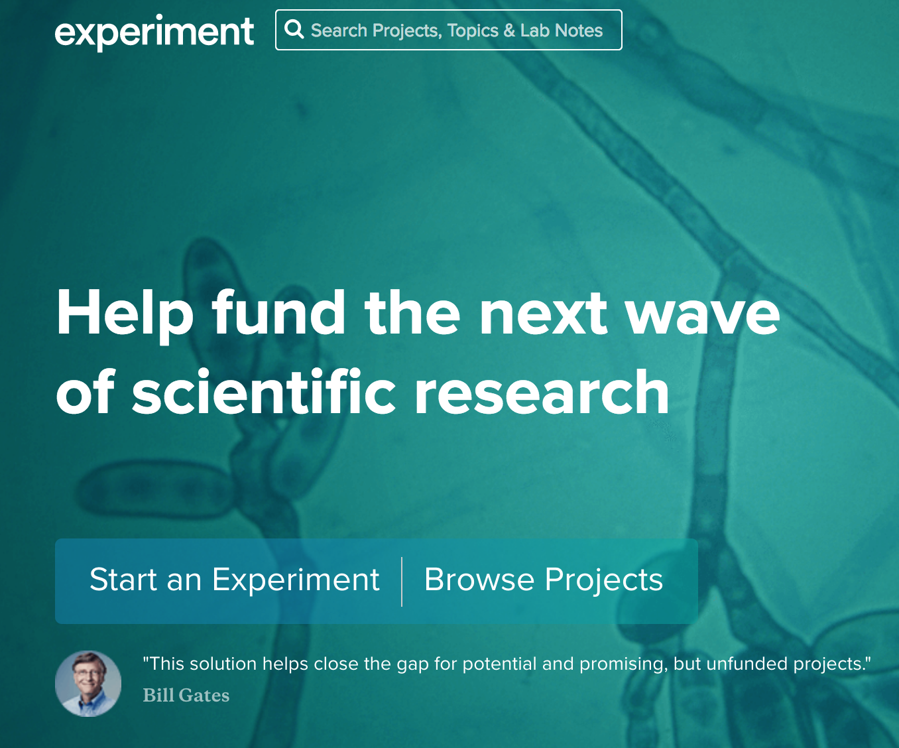


Slide 18
Summary
Science isn’t a stand along thing it is part of culture and society
We have a mass of potential we could be using much better
Think outside of the box
The underground is becoming mainstraim
It also will inspire your own ‘day job’
People love science!

Slide 19
Further Info
Speak to me today!
Twitter: @Janetteedson
Janette.Edson@uqconnect.edu.au
BioBase email: biobaseqld@gmail.com

